Slide 1

Object Oriented Software Engineering
Lecture 6

Slide 2
Today’s Outline:
Requirement Engineering:
Requirement Engineering Tasks
Initiating Requirement
Engineering Process
Eliciting Requirements

Slide 3
Introduction:
Requirement Engineering:
Requirements engineering is the process of identifying, eliciting, analyzing, specifying, validating, and managing the needs and expectations of stakeholders for a software system. The requirements engineering process is an iterative process that involves several steps, including:
Requirements Elicitation: This is the process of gathering information about the needs and expectations of stakeholders for the software system. This step involves interviews, surveys, focus groups, and other techniques to gather information from stakeholders.

Slide 4
Introduction:
Requirements Analysis: This step involves analyzing the information gathered in the requirements elicitation step to identify the high-level goals and objectives of the software system. It also involves identifying any constraints or limitations that may affect the development of the software system.
Requirements Specification: This step involves documenting the requirements identified in the analysis step in a clear, consistent, and unambiguous manner. This step also involves prioritizing and grouping the requirements into manageable chunks.

Slide 5
Introduction:
Requirements Validation: This step involves checking that the requirements are complete, consistent, and accurate. It also involves checking that the requirements are testable and that they meet the needs and expectations of stakeholders.
Requirements Management: This step involves managing the requirements throughout the software development life cycle, including tracking and controlling changes, and ensuring that the requirements are still valid and relevant.
The Requirements Engineering process is a critical step in the software development life cycle as it helps to ensure that the software system being developed meets the needs and expectations of stakeholders, and that it is developed on time, within budget, and to the required quality.

Slide 6
Introduction:
Requirement Engineering is the process of defining, documenting and maintaining the requirements. It is a process of gathering and defining service provided by the system. it is the disciplined application of proven principle , methods ,tools and notations to describe a proposed system’s intended behavior and its associated constraints.
Tools involved in requirement engineering:
observation report
Questionnaire ( survey , poll )
Use cases
User stories
Requirement workshop
Mind mapping
Role playing
Prototyping

Slide 7
Requirement Engineering
The process to gather the software requirements from client, analyze and document them is known as requirement engineering.
The goal of requirement engineering is to develop and maintain sophisticated and descriptive ‘System Requirements Specification’ document.

Slide 8
Introduction to requirement engineering
The process of collecting the software requirement from the client then understand, evaluate and document it is called as requirement engineering.
Requirement engineering constructs a bridge for design and construction.

Slide 9
Introduction to requirement engineering
Requirement engineering consists of seven different tasks as follow:
1. Inception: Inception is a task where the requirement engineering asks a set of questions to establish a software process.
In this task, it understands the problem and evaluates with the proper solution.
It collaborates with the relationship between the customer and the developer.
The developer and customer decide the overall scope and the nature of the question.

Slide 10
Introduction to requirement engineering
2. Elicitation
Elicitation means to find the requirements from anybody. The requirements are difficult because the following problems occur in elicitation. Problem of scope: The customer give the unnecessary technical detail rather than clarity of the overall system objective. Problem of understanding: Poor understanding between the customer and the developer regarding various aspect of the project like capability, limitation of the computing environment. Problem of volatility: In this problem, the requirements change from time to time and it is difficult while developing the project.

Slide 11
Introduction to requirement engineering
3. Elaboration: In this task, the information taken from user during inception and elaboration and are expanded and refined in elaboration.
Its main task is developing pure model of software using functions, feature and constraints of a software.
4. Negotiation: In negotiation task, a software engineer decides the how will the project be achieved with limited business resources.
To create rough guesses of development and access the impact of the requirement on the project cost and delivery time.

Slide 12
Introduction to requirement engineering
5. Specification: In this task, the requirement engineer constructs a final work product.
The work product is in the form of software requirement specification.
In this task, formalize the requirement of the proposed software such as informative, functional and behavioral.
The requirement are formalize in both graphical and textual formats.
6. Validation: The work product is built as an output of the requirement engineering and that is accessed for the quality through a validation step.
The formal technical reviews from the software engineer, customer and other stakeholders helps for the primary requirements validation mechanism.

Slide 13
Introduction to requirement engineering
7. Requirement management: It is a set of activities that help the project team to identify, control and track the requirements and changes can be made to the requirements at any time of the ongoing project.
These tasks start with the identification and assign a unique identifier to each of the requirement.
After finalizing the requirement traceability table is developed.
The examples of traceability table are the features, sources, dependencies, subsystems and interface of the requirement.

Slide 14
Eliciting Requirements
Eliciting requirement helps the user for collecting the requirement Eliciting requirement steps are as follows: 1. Collaborative requirements gathering:
Gathering the requirements by conducting the meetings between developer and customer.
Fix the rules for preparation and participation.
The main motive is to identify the problem, give the solutions for the elements, negotiate the different approaches and specify the primary set of solution requirements in an environment which is valuable for achieving goal.

Slide 15
Eliciting Requirements
2. Quality Function Deployment (QFD)In this technique, translate the customer need into the technical requirement for the software.
QFD system designs a software according to the demands of the customer.

Slide 16
Eliciting Requirements
QFD consist of three types of requirement:
Normal requirements: The objective and goal are stated for the system through the meetings with the customer.
For the customer satisfaction these requirements should be there.
Expected requirement: These requirements are implicit.
These are the basic requirement that not be clearly told by the customer, but also the customer expect that requirement.
Exciting requirements: These features are beyond the expectation of the customer.
The developer adds some additional features or unexpected feature into the software to make the customer more satisfied. For example, the mobile phone with standard features, but the developer adds few additional functionalities like voice searching, multi-touch screen etc. then the customer more exited about that feature.

Slide 17
Eliciting Requirements
3. Usage scenarios: Till the software team does not understand how the features and function are used by the end users it is difficult to move technical activities.
To achieve above problem the software team produces a set of structure that identify the usage for the software.
This structure is called as 'Use Cases'.
4. Elicitation work product: The work product created as a result of requirement elicitation that is depending on the size of the system or product to be built.
The work product consists of a statement need, feasibility, statement scope for the system.
It also consists of a list of users participate in the requirement elicitation.

Slide 18
Requirement Engineering
Requirement Engineering is the process of defining, documenting and maintaining the requirements. It is a process of gathering and defining service provided by the system. Requirements Engineering Process consists of the following main activities:
Requirements elicitation
Requirements specification
Requirements verification and validation
Requirements management

Slide 19
Requirement Engineering
Requirements elicitation
It is related to the various ways used to gain knowledge about the project domain and requirements. The various sources of domain knowledge include customers, business manuals, the existing software of same type, standards and other stakeholders of the project. The techniques used for requirements elicitation include interviews, brainstorming, task analysis, Delphi technique, prototyping, etc.

Slide 20
Requirements elicitation
There are several techniques that can be used to elicit requirements, including:
Interviews: These are one-on-one conversations with stakeholders to gather information about their needs and expectations.
Surveys: These are questionnaires that are distributed to stakeholders to gather information about their needs and expectations.
Focus Groups: These are small groups of stakeholders who are brought together to discuss their needs and expectations for the software system.
Observation: This technique involves observing the stakeholders in their work environment to gather information about their needs and expectations.
Prototyping: This technique involves creating a working model of the software system, which can be used to gather feedback from stakeholders and to validate requirements.

Slide 21
Requirement Engineering
Requirements specification: This activity is used to produce formal software requirement models. All the requirements including the functional as well as the non-functional requirements and the constraints are specified by these models in totality. During specification, more knowledge about the problem may be required which can again trigger the elicitation process.

Slide 22
Requirements specification
There are several types of requirements that are commonly specified in this step, including:
Functional Requirements: These describe what the software system should do. They specify the functionality that the system must provide, such as input validation, data storage, and user interface.
Non-Functional Requirements: These describe how well the software system should do it. They specify the quality attributes of the system, such as performance, reliability, usability, and security.
Constraints: These describe any limitations or restrictions that must be considered when developing the software system.
Acceptance Criteria: These describe the conditions that must be met for the software system to be considered complete and ready for release.

Slide 23
Requirement Engineering
Requirements verification and validation:
Verification: It refers to the set of tasks that ensures that the software correctly implements a specific function. Validation: It refers to a different set of tasks that ensures that the software that has been built is traceable to customer requirements.
It’s important to note that V&V is not a one-time process, but it should be integrated and continue throughout the software development process and even in the maintenance stage.

Slide 24
Requirements management:
Requirements management:
Requirement management is the process of analyzing, documenting, tracking, prioritizing and agreeing on the requirement and controlling the communication to relevant stakeholders. This stage takes care of the changing nature of requirements. It should be ensured that the SRS is as modifiable as possible so as to incorporate changes in requirements specified by the end users at later stages too.

Slide 25
Requirements management:
Requirements management:
There are several key activities that are involved in requirements management, including:
Tracking and controlling changes: This involves monitoring and controlling changes to the requirements throughout the development process, including identifying the source of the change, assessing the impact of the change, and approving or rejecting the change.
Version control: This involves keeping track of different versions of the requirements document and other related artifacts.
Traceability: This involves linking the requirements to other elements of the development process, such as design, testing, and validation.
Communication: This involves ensuring that the requirements are communicated effectively to all stakeholders and that any changes or issues are addressed in a timely manner.
Monitoring and reporting: This involves monitoring the progress of the development process and reporting on the status of the requirements.

Slide 26
Requirement Engineering Process
Requirement Engineering Process
It is a four step process, which includes –
Feasibility Study
Requirement Gathering
Software Requirement Specification
Software Requirement Validation

Slide 27
Requirement Engineering Process
Feasibility study
When the client approaches the organization for getting the desired product developed, it comes up with rough idea about what all functions the software must perform and which all features are expected from the software.
This feasibility study is focused towards goal of the organization. This study analyzes whether the software product can be practically materialized in terms of implementation, contribution of project to organization, cost constraints and as per values and objectives of the organization. It explores technical aspects of the project and product such as usability, maintainability, productivity and integration ability.
The output of this phase should be a feasibility study report that should contain adequate comments and recommendations for management about whether or not the project should be undertaken.

Slide 28
Requirement Engineering Process
Requirement Gathering
If the feasibility report is positive towards undertaking the project, next phase starts with gathering requirements from the user. Analysts and engineers communicate with the client and end-users to know their ideas on what the software should provide and which features they want the software to include.

Slide 29
Requirement Engineering Process
Software Requirement Specification
SRS is a document created by system analyst after the requirements are collected from various stakeholders.
SRS defines how the intended software will interact with hardware, external interfaces, speed of operation, response time of system, portability of software across various platforms, maintainability, speed of recovery after crashing, Security, Quality, Limitations etc.

Slide 30
Requirement Engineering Process
Software Requirement Validation
After requirement specifications are developed, the requirements mentioned in this document are validated. User might ask for illegal, impractical solution or experts may interpret the requirements incorrectly. This results in huge increase in cost if not nipped in the bud. Requirements can be checked against following conditions -
If they can be practically implemented
If they are valid and as per functionality and domain of software
If there are any ambiguities
If they are complete
If they can be demonstrated

Slide 31

Requirement Elicitation Process
Requirement elicitation process can be depicted using the following diagram:

Slide 32
Requirement Elicitation Process
Requirements gathering - The developers discuss with the client and end users and know their expectations from the software.
Organizing Requirements - The developers prioritize and arrange the requirements in order of importance, urgency and convenience.
Negotiation & discussion - If requirements are ambiguous or there are some conflicts in requirements of various stakeholders, if they are, it is then negotiated and discussed with stakeholders. Requirements may then be prioritized and reasonably compromised.
The requirements come from various stakeholders. To remove the ambiguity and conflicts, they are discussed for clarity and correctness. Unrealistic requirements are compromised reasonably.
Documentation - All formal & informal, functional and non-functional requirements are documented and made available for next phase processing.

Slide 33
Requirement Elicitation Techniques
Requirements Elicitation is the process to find out the requirements for an intended software system by communicating with client, end users, system users and others who have a stake in the software system development.
There are various ways to discover requirements:
Interviews
Surveys
Questionnaires
Task analysis
Domain Analysis
Brainstorming
Prototyping
Observation

Slide 34
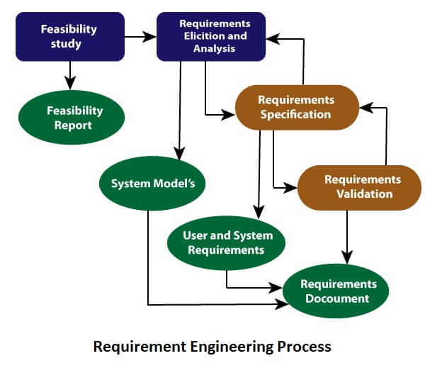
Requirement Engineering Process

Slide 35
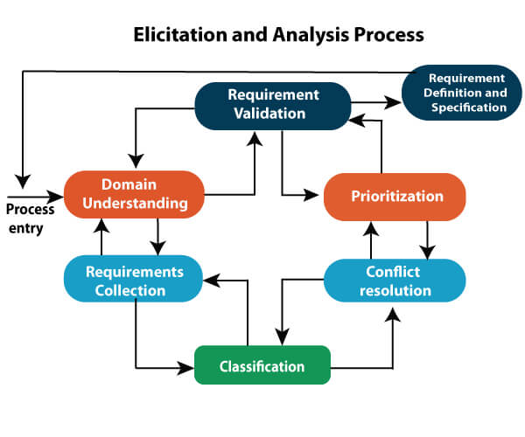
Requirement Elicitation and Analysis:

Slide 36
Thank You

